Slide 1





Capstone Project
Company Valuation Template 1010142
Presentation

Slide 2



Login and registration page
Animated login - registration page
Html and css as a front-end languages
PHP as a back-end language

Slide 3

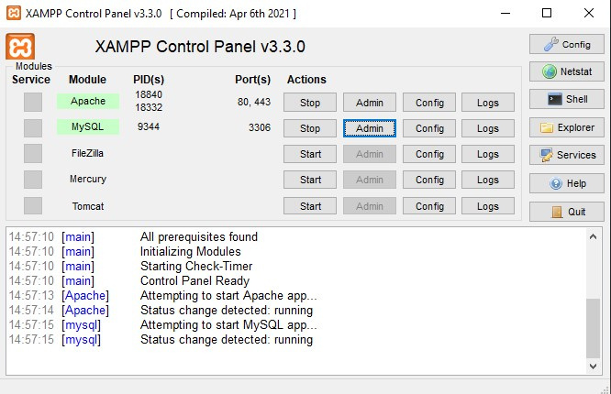
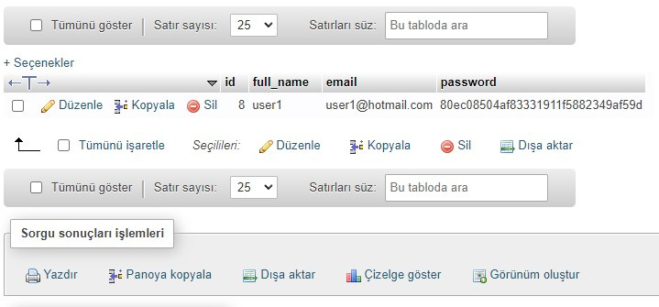
SERVER AND DATABASE
XAMPP Control Panel for local server
PHPMyAdmin and MySQL for database
Encrypted password

Slide 4
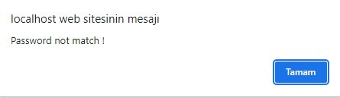
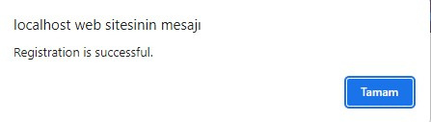
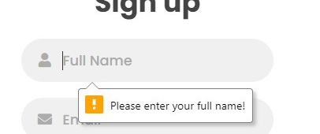
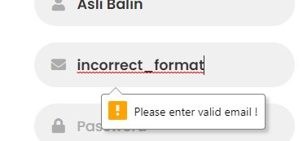
FORM ERRORS AND NOTIFICATIONS
Unmatched password case
Successfull registration
Empty inputs
Incorrect type of input

Slide 5
ABOUT FINANCIALS AND TEMPLATE
Implementation of all three methods are done.
Weighted Average is used for the final demonstration
Files of other companies will be added
Streamlit framework is used
User has two option which are select company from list or upload a document in same format

Slide 6
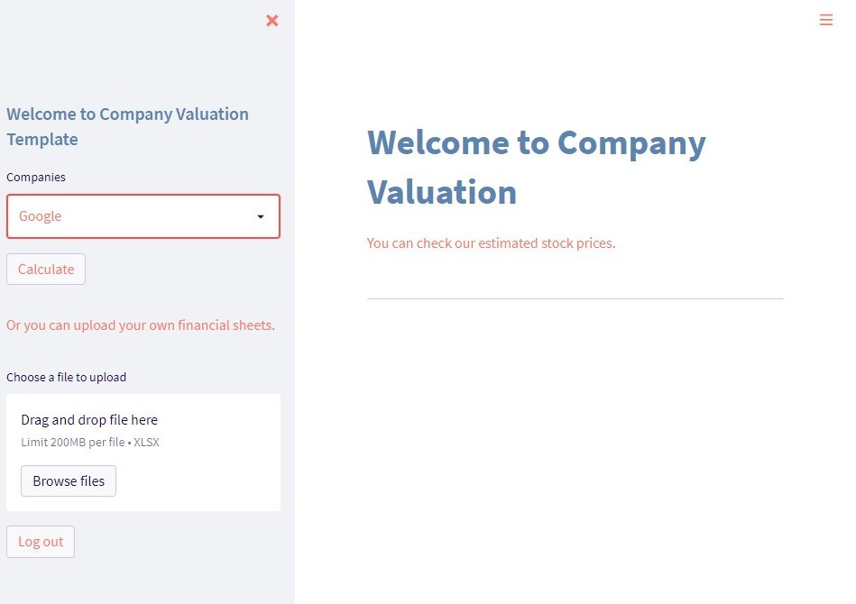
One page with sidebar a sidebar
Interface with a minimum complexity
User able to choose or upload

Slide 7
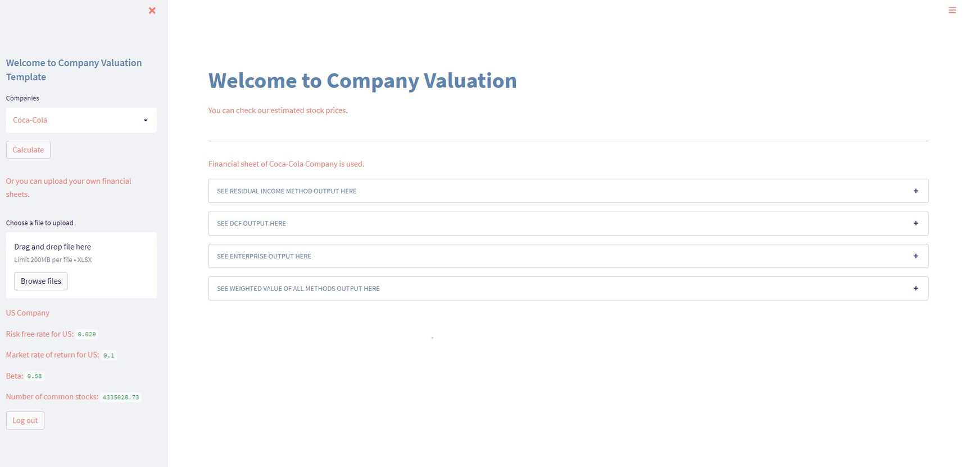
When user select and click
button
Unique values for companies are
also shown in sidebar
Country constants are shown
according to company
4 container with inner outputs

Slide 8
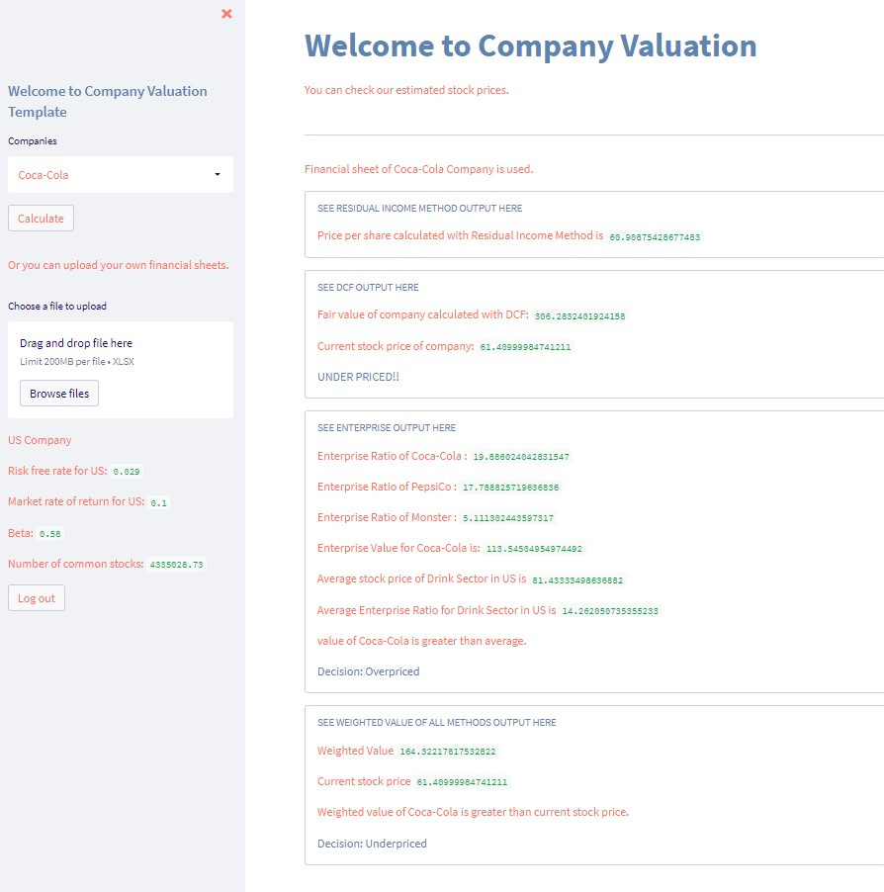
1st Residual Income Method
2nd DCF Method
3rd Enterprise Ratios and Value
4th Weighted result of all methods

Slide 9
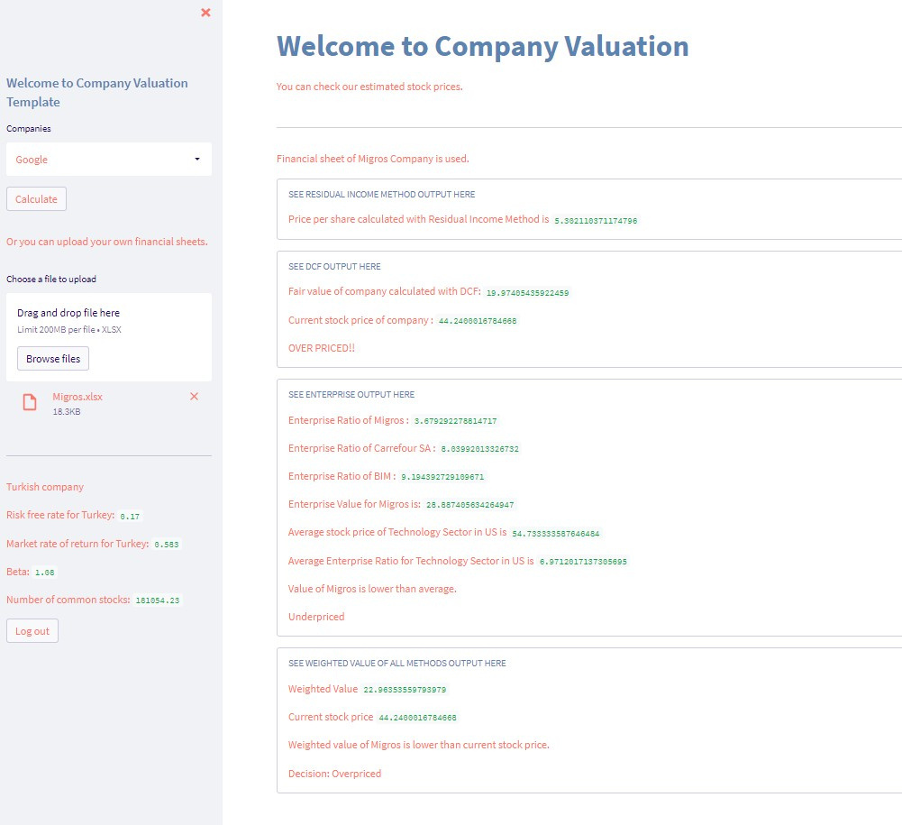


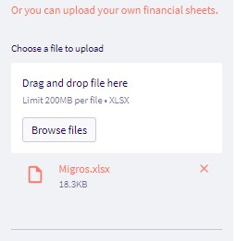
Same structure and result with upload part
Constants and unique values shown
again

Slide 10
RESPONSIBILITIES
Login - registration page (Person 3)
Database connection with Login - Resgistration (Person 4 , Me)
Implementation of DCF Method (Person 4)
Implementation of Enterprise Method (Person 3)
Residual Income and dashboard design (Together)

Slide 11
Management Engineering Sub-Team
The team will be responsible for the financial analysis and the required calculations for the financial methodology.
Providing some guidance or help to the investors, through the financial model to buy, sell or hold their stocks.

Slide 12
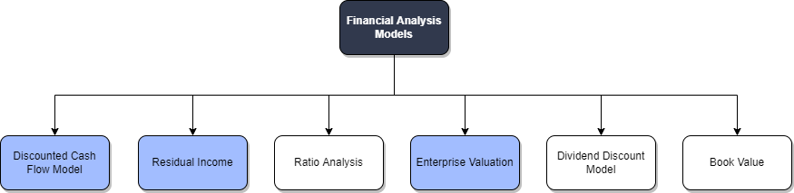
Financial Models/Methodologies

Slide 13
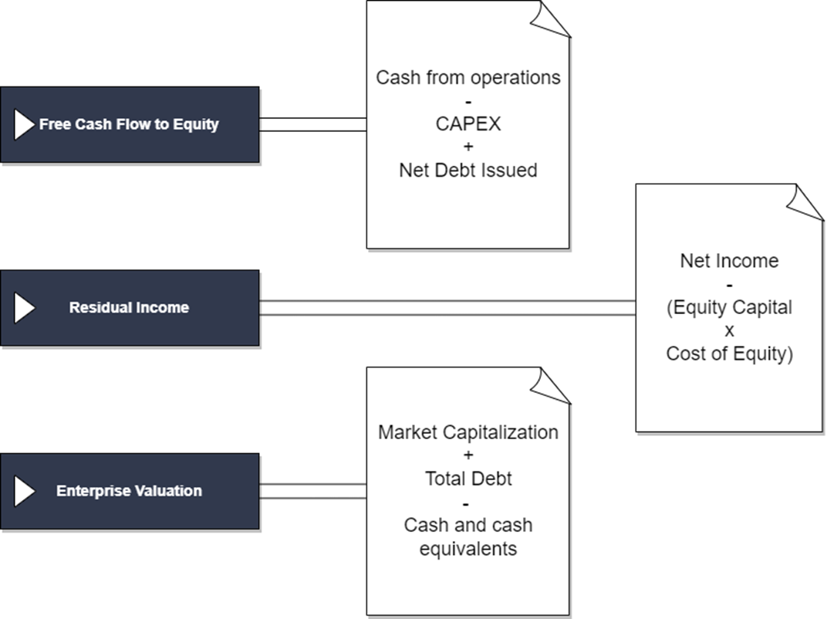
Financial Models/Methodologies

Slide 14
Assumptions
During conducting the analysis using the three methods mentioned before, we came across a number of constraints from the financial side.
Therefore, we decided to put some assumptions that could change until the ending of the project, which will also be mentioned in the final project presentation.

Slide 15
Assumptions for Turkish Markets
Tax Rate | US Risk Free Rates (Rf) | Market Risk Premium Rate in the US | Perpetual Growth of the Company
23% | 17% | 58.3% | 2.5%
We took the absolute value of any growth rates, to keep the calculations consistent.

Slide 16
Assumptions for US Markets
Tax Rate | US Risk Free Rates (Rf) | Market Risk Premium Rate in the US | Perpetual Growth of the Company
18% | 2.9% | 10% | 2.5%

Slide 17
Methodology

Slide 18
Present Results
After conducting the three financial analysis models, we decided on the following:
DCF method works on well established emerging markets companies.
Residual Income method works on developed markets.
Enterprise Valuation worked for both, but the comparison will be conducted in later stages.
The above-mentioned results could change in the final stage of the project, because our analysis/testing is still in progress.

